Slide 1
CS6456: Graduate Operating Systems
Brad Campbell – bradjc@virginia.edu
https://www.cs.virginia.edu/~bjc8c/class/cs6456-f19/

Slide 2

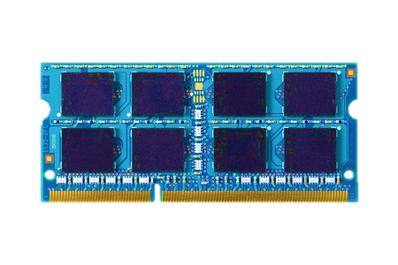

Two-level storage model
CPU
Ld/St
VOLATILE
MEMORY
FAST
DRAM
BYTE ADDR
FILE
I/O
STORAGE
NONVOLATILE
SLOW
BLOCK ADDR

Slide 3
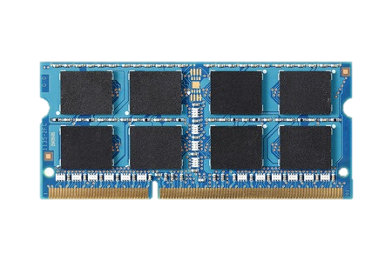
Two-level storage model
CPU
Ld/St
VOLATILE
MEMORY
FAST
DRAM
BYTE ADDR
FILE
I/O
NVM
STORAGE
PCM, STT-RAM
NONVOLATILE
SLOW
BLOCK ADDR
Non-volatile memories combine characteristics of memory and storage

Slide 4
Vision: Unify memory and storage
CPU
Ld/St
PERSISTENTMEMORY
NVM
Provides an opportunity to manipulate persistent data directly

Slide 5
DRAM is still faster
CPU
CPU
Ld/St
PERSISTENTMEMORY
MEMORY
DRAM
NVM
A hybrid unified
memory-storage system

Slide 6
Unify memory and storage
Opportunity to update data in-place in memory with Ld/St interface
Do not need to move data from disk to memory, translate file to data structure and transfer to disk again
Eliminates wasted work to locate, transfer, and translate data
Improves both energy and performance
Simplifies programming model as well

Slide 7
End-to-end system for persistent memory
PROBLEM
How to write consistent code?
CPU
How to allocate objects in persistent memory?
APPLICATION
Software
COMPILER
How to annotate and verify applications?
PERSISTENTMEMORY
Ld/St
PERSISTENT MANAGER
How to manage unified memory and storage support?
ARCHITECTURE
How to provide hardware support?
Hardware
CIRCUITS
How to reduce wear-out?
GOAL: A full stack support for persistent memory applications
Jinglei Ren+, “Dual-Scheme Checkpointing: A Software-Transparent Mechanism for Supporting Crash Consistency in Persistent Memory Systems”, MICRO 2015
Justin Meza+, “A Case for Efficient Hardware-Software Cooperative Management of Storage and Memory”, WEED 2013
Sihang Liu+, “Crash Consistency for Encrypted Non-Volatile Main Memory Systems”, HPCA 2018

Slide 8

NVMOVE: Helping Programmers Move to Byte-based Persistence
NVMOVE
Himanshu Chauhan
with
Irina Calciu, Vijay Chidambaram,
Eric Schkufza, Onur Mutlu, Pratap Subrahmanyam
Chauhan, H., Calciu, I., Chidambaram, V., Schkufza, E., Mutlu, O., & Subrahmanyam, P. (2016). NVMOVE: Helping Programmers Move to Byte-Based Persistence. INFLOW@OSDI.

Slide 9
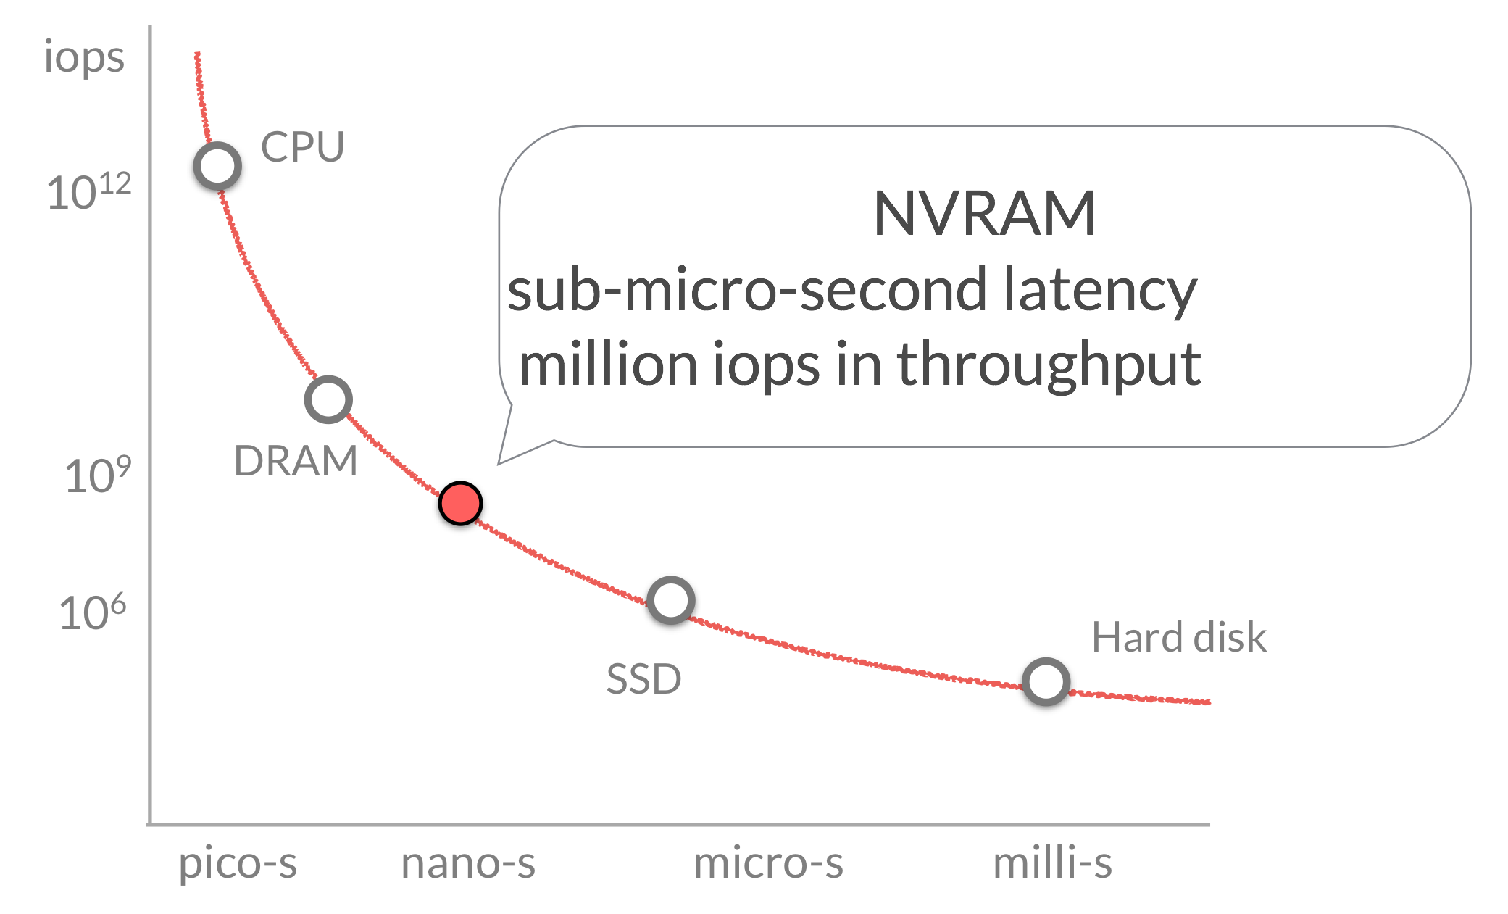
Fast, but volatile.
Cache
DRAM
SSD
Persistent, but slow.
Hard Disk
Notes:
In terms of throughput and latency, it sits roughly somewhere here. And thus has great potential for boosting performance of new applications.

Slide 10
Persistent Programs
typedef struct {
} node
1. allocate from memory
2. data read/write + program logic
3. save to storage
Notes:
Let us consider persistent prorgrams that save their state or data to storage.

Slide 11
Persistence Today
Notes:
Consider a binary search tree. If we want to persist it, we will have to perform these or very similar operations.

Slide 12
Persistence with NVM
Notes:
we know that this promise-land exists for programming new applications.
but what about exsiting persistent programs. how can we improve them to leverage nvm?

Slide 13

Changing Persistent Code
Present
NVM
/* allocate from volatile memory*/
node n* = malloc(sizeof(…))
/* allocate from non-volatile memory*/
node n* = pmalloc(sizeof(…))
node->value = val //volatile
update
…
node->value = val //persistent
update
…
/* persist to block-storage*/
char *buf= malloc(sizeof(…));
int fd = open("data.db",O_WRITE);
sprintf(buf,"…", node->id,
node->value);
write(fd, buf, sizeof(buf));
/* flush cache and commit*/
__cache_flush + __commit

Slide 14
Porting to NVM: Tedious
Identify data structures that should be on NVM
Update them in a consistent manner
Redis: simple key-value store (~50K LOC) - Industrial effort to port Redis is on-going after two years
- Open-source effort to port Redis has minimum functionality

Slide 15
Goal:
Port existing applications to NVM with minimal programmer involvement.

Slide 16

Requirement: find persistent types in source
User defined source types (structs in C)
that are persisted to block-storage.
Application Code
Block Storage

Slide 17

Application Code
write system call
Block Storage

Slide 18
node *n = malloc(sizeof(node))
node
iter *it = malloc(sizeof(iter))
/* persist to block-storage*/
char *buf= malloc(…))
int fd = open(…)
sprintf(buf,”…”,node->value)
write(fd, buf, …)
write system call

Slide 19
node
/* write to network socket*/
…
write(socket, “404”, …)
/* write to error stream*/
…
write(stderr, “All is lost.”, …)
/* persist to block-storage*/
…
write(fd, buf, …)
write system call
Pipe
Storage
Network

Slide 20

node
Save to block-storage
Load/recover
Block Storage

Slide 21
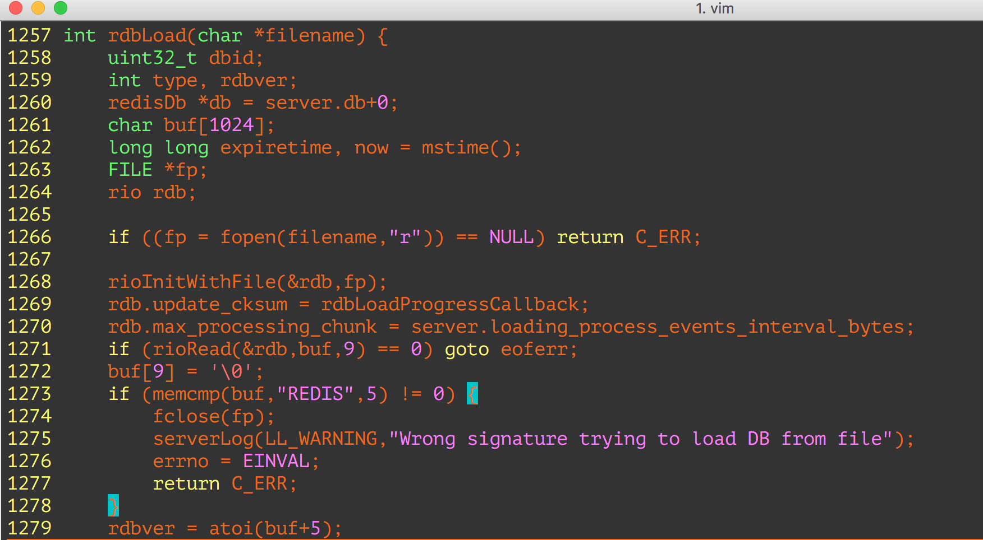

“rdbLoad” is the load/recovery function.

Slide 22
Mark every type that can be created during the recovery.
rdbLoad
external
library

Slide 23
Search the call graph to find types
Application type created/modified
external
library

Slide 24

Evaluation: redis
In-memory data structure store
strings, hashes, lists, sets, indexes
Persistence
— data-snapshots(RDB),
— command-logging (AOF)
~50K lines-of-code

Slide 25
Identification Accuracy
122 types (structs) in Redis Source
Notes:
fortunately for us, an industrial team has already gone thru the painful and laborious process of manually porting redis to nvm. So all we had to do was to ask them for the list of types that they make persistent in their implementaiton.

Slide 26
Identification Accuracy

Slide 27
Identification Accuracy
Total types: 122
NVMOVE identified persistent types 25
True positives (manually identified) 14
False positives 11
False negatives 0

Slide 28
YCSB Benchmark Results
write-heavy (90% update, 10% read)
27K ops/s
in-memory (=1.0)
Possible Data loss
111 MB
Fraction of
in-memory
throughput

Slide 29


Slide 30



Log-Structured Non-Volatile Main Memory
Qingda Hu*, Jinglei Ren, Anirudh Badam, and Thomas Moscibroda Microsoft Research *Tsinghua University

Slide 31


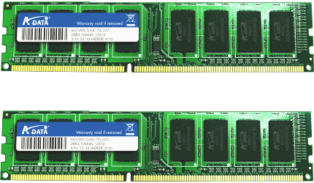
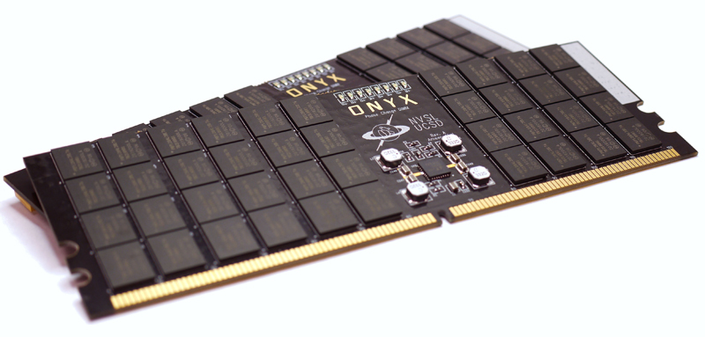

Non-volatile memory is coming…
Data storage
3D XPoint/Optane (2015 - )
Read: ~50ns
Write: ~10GB/s
PCM
Read: ~100ns
Write: ~1GB/s
Read: ~10µs
Write: ~100MB/s

Slide 32



Background: Impact of NVM
Architecture:
Data persistence as a bottleneck
➔ 10+x application performance improvement
Non-Volatile Main Memory (NVMM)
DRAM
DRAM
NVM
SSD

Slide 33
Executive Summary
Motivation
Solution: Log-structured memory management for NVMM.
Evaluation: 7x less memory waste; 90% higher write throughput.
Application
Application
Library
Library
Inefficient use of memory space
DRAM
NVMM
Inefficient support for crash consistency
SSD

Slide 34
Outline
Motivation
Log-Structured NVMM
Tree-Based Address Mapping
Evaluation

Slide 35
Motivation I
Inefficient use of memory space
Reason: Traditional DRAM allocators incur high memory fragmentation.
Explanation:
Internal fragmentation:
External fragmentation:
8B
16B
…
8B | 8B | 8B | 8B | 8B | … | 8B | 8B
……
16B | 16B | … | 16B
……
…
……
32B
24B
Waste
64B request
32B | Waste (32B) | 32B | 32B | Waste (32B)

Slide 36
Motivation I
Inefficient use of memory space (cont.)
Fragmentation is a more severe issue for NVM!
process
process
process
process
process
process
DRAM
NVMM
Notes:
For NVM, fragmentation is a more severe issue. DRAM can accept a reasonable level of fragmentation because data occupation tends to be temporary.
It is OK to waste some space for a short while. But for NVM, data occupation is supposed to be permanent.

Slide 37
Motivation II
Inefficient support for crash consistency
Reason: Write-twice in log and home.
Explanation: Redo logging for example.
transaction {
a += 1;
b -= 1;
}
NVMM
Home
a
b
Log
a’
b’
Notes:
If the transaction is interrupted by a crash, it must either roll back to the beginning state, or roll forward to the end state. To maintain such crash consistency, we cannot directly update A and B in-place.
Instead, we have to first log the new values in a special logging area.
Only after that, we update A and B in-place. Suppose the transaction is crashed. We can roll forward the transaction using the new values in the log. So, there is nothing wrong with crash consistency. But we can see that A and B are both written twice, once in the log, and once in the home. Such write-twice behavior largely reduces the write throughput of NVM and increases its wear-out. Wear-out is also critical for NVM because its endurance is limited.

Slide 38
Outline
Motivation
Log-Structured NVMM
Tree-Based Address Mapping
Evaluation

Slide 39
Log-Structured NVMM
Library and architecture
Process (user space)
Address mapping (DRAM)
Transaction
Home addr. | Log addr.
&a
&b | …
translate(&a)
a
a’
Allocated | Available
a
Memory management: An append-only log
mmap()
 | Application X
NVM device
Notes:
The log-structured NVMM is a user-space library by which applications can allocate or free NVM space and access NVM data through transactions.
This library manages part of the physical NVM that is assigned to a certain application. We assume OS decides which NVM part is assigned. Our library just maps whatever given NVM to the process memory space.
Then, the whole NVM space is organized as a large append-only log. There is no separate log and home areas.
When there is an allocation or write, the new data is always added to the end of the log.
An address translation mechanism translates an address in application view to the real address in the log. So, every NVM access has to call an address translate function. Internally, our library maintains an address mapping structure to perform the translation. In our system, we put address mappings in DRAM for better performance. If the address mappings are lost due to a crash, they can be rebuilt from the log. So, access or update to address mappings does not involve NVM.

Slide 40
Log-Structured NVMM
Low fragmentation
For internal fragmentation: Compact append
For external fragmentation: Log cleaning
Allocated | Available
a
No internal fragmentation
Allocated | Available
a
a’
Notes:
For memory fragmentation, we completely avoid internal fragmentation because all data is compactly appended to the log. There is just no fragment between them.
Meanwhile, external fragmentation still exists. For example, suppose A is updated and the new value is appended to the log. Then the old value is free, making a fragment. We deal with such external fragmentation by log cleaning. Here is what we do.
The huge log physically consists of a linked list of chunks. Periodically, we scan some chunks and collect valid data to a new chunk.
Then, the original chunks can be reused. So, fragments are gone. After those data movements, we need to update the address mappings accordingly. Essentially, it is the address mapping facility that enables removal of external fragmentation. Overall, our library can effectively overcome the fragmentation issue and reduce memory waste.

Slide 41
Log-Structured NVMM
Efficient crash-consistent update
No separate areas. Write only once.
Header: size, checksum, etc.
transaction {
a += 1;
b -= 1;
}
Address mapping
Home addr. | Log addr.
&a
&b
a
b
a’
b’
Allocated | Available
Notes:
For the second problem, maintaining crash consistency, we no longer need to write data twice, because we don't have separate log and home areas. The whole NVM is just a log.
Take the transaction for example. Initially, A and B are mapped to some addresses in the log. To update them, we append their new values to the log along with some metadata. The metadata includes a checksum of the new values. Suppose a crash interrupts the transaction. We can verify the checksum on recovery. If it is invalid, we simply truncate the log and discard new values. In this way, we write A and B only once but still guarantees crash consistency. In most cases, we can save a significant amount of write traffic, leading to high throughput and low wear-out. In summary, the log-structured approach solves the two problems. But applying it to the main memory is not as easy as it sounds.

Slide 42
Outline
Motivation
Log-Structured NVMM
Tree-Based Address Mapping
Evaluation

Slide 43


Tree-Based Address Mapping
Unique challenges to NVMM
Pervasive and highly frequent memory accesses.
Allocation granularity ≠ access granularity ➔ No O(1) lookup.
Filesystems: hash(block number) as the index.
Databases: hash(key or tuple ID) as the index.
Main memory: hash(address)? That maps every address!
Tree-based mapping made performant.
0xABB4, size=16
? 0xABC8
0xABC0, size=24
...
Notes:
Although the log-structured approach has been used in filesystems and databases. NVM brings two unique challenges.
First, every NVM access needs address translation, so the frequency is very high, orders of magnitude higher than disk I/Os. That requries very high performance of address translation.
Second, in main memory, the allocation granularity is not equivalent to the access granularity. That means we cannot directly use O(1) data structures like hash table to do the address mapping. In main memory, an application can allocate an area at some address, but access any arbitrary address in that area. So, which address should we use to index that area? Definitely, we cannot map every memory address.
Therefore, the only viable way to map memory addresses is to use a tree data structure. In such a tree, each node holds the starting address and the size of an allocated area. We only need to index the staring address of an allocated area. Different from hash table, a tree maintains the order of indexed addresses. So we can find nearby addresses. For example, an application allocates a 24B area at the address 0xABC0. If the application queries the address 0xABC8, we can go down the tree and find the node 0xABC0 that contains the target address. So, a tree enables using the allocation granularity to serve arbitrary access.
In summary, we need a tree structure for address mapping and the tree has to be very performant.

Slide 44

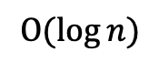
Tree-Based Address Mapping
Two-layer mapping
Partition index: $Ο(1)$
……
……
……
Tree for a small
partition (4KB)
$$Ο(\log{n})$$
Improves transaction throughput by 39.6% on average.
Notes:
We designed four techniques to achieve good enough performance. The first one is two-layer mapping.
The height of a tree determines the average tree operation overhead, so we cut the tree. Particularly, we divide the NVM space into fixed-length partitions, so just O(1) cycles are necessary to find the partition for an address. This is the first layer of mapping.
Then, for each partition, we use a small tree as the second-layer mapping. Since the partition size is very small, typically 4KB, such a partition-local tree has a largely reduced height.
According to our evaluation with various workloads, this optimization improves transaction throughput by almost 40% on average.

Slide 45
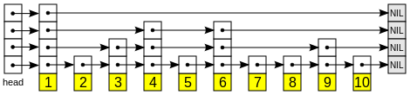
Tree-Based Address Mapping
Skip list
……
A probabilistically balanced tree. No complex balancing operations ➔ No locking for read-only operations.
Improves transaction throughput by 48.9% with four threads.
Notes:
The second optimization is using the skip list for the tree. A problem with a regular strictly balanced tree like a B-tree is that it requires complex tree balancing operations. As a result, every access to the tree has to hold a lock, which easily becomes the bottleneck.
In contrast, the skip list is a probabilistic tree structure without balancing operations. A skip list consists of several singly linked lists of nodes to form a tree structure. I don't go to details here but what we can achieve is lock-free lookup operations.
Our observation is that avoiding lock for very frequent lookup operations improves the transaction throughput by almost 50% with four threads.

Slide 46
Tree-Based Address Mapping
Group update
Within each transaction, all writes are first buffered in DRAM.
Writes with contiguous addresses are combined on transaction commit.
Improves transaction throughput by 42.3% on average.

Slide 47
Tree-Based Address Mapping
Hot tree node cache
A thread-local cache that references recently accessed nodes of the trees.
A special hash table design: Deliberately high collision.
Motivation: Addresses within a cached node are not hit due to random distribution of their hash values.
Solution: Use high-order bits of an address as its hash value.
Improves transaction throughput by 30.1% on average.
0xABB*
0xABC*
0xABD*
0xABC00 (size=24)
0xABCD0 (size=16)
? 0xABC08
Collison and found!
Notes:
Finally, the fourth optimization is hot tree node cache. It is a thread-local hash table that stores references to recently accessed tree nodes.
We make a special design for this hash table. Regularly, we don't want collision in a hash table. But in this case, we deliberately increase the collision. Recall the reason why we need a tree structure instead of a hash table for address mapping. It is the same problem here. Addresses nearby a cached address are not hit in a regular hash table.
So, we came up with a simple solution: use high-order bits of an address as its hash value. Nearby addresses of a cached address tend to be a collision and encounter the cached node. Overall, the tree node cache improves transaction throughput by over 30% on average.

Slide 48
Outline
Motivation
Log-Structured NVMM
Tree-Based Address Mapping
Evaluation

Slide 49
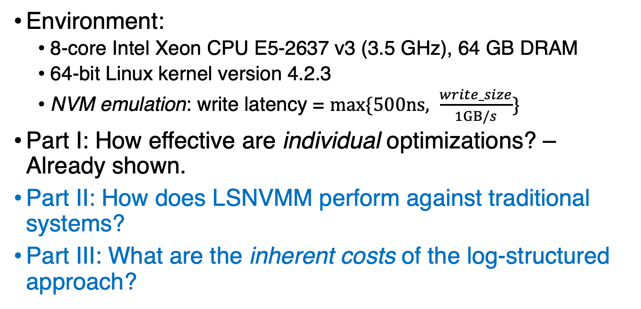
Evaluation
Environment:
8-core Intel Xeon CPU E5-2637 v3 (3.5 GHz), 64 GB DRAM
64-bit Linux kernel version 4.2.3
NVM emulation: write latency = $max⁡\{500ns, \frac{write_size}{1GB/s}\}$
Part I: How effective are individual optimizations? – Already shown.
Part II: How does LSNVMM perform against traditional systems?
Part III: What are the inherent costs of the log-structured approach?

Slide 50
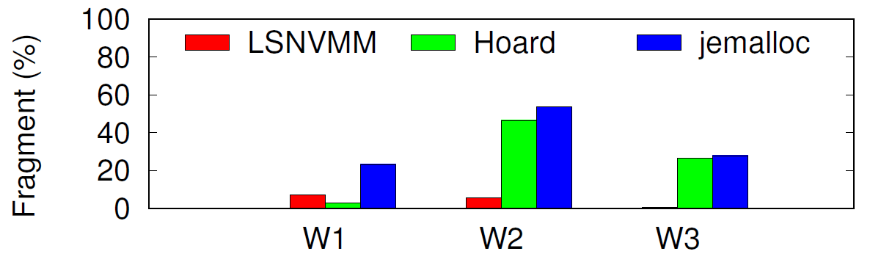
Evaluation
Fragmentation: Compared to Hoard and jemalloc
Workloads 1 ~ 3 collected from [S. Rumble, FAST ’14].
Hoard/jemalloc produces 25.3%/35.0% fragmentation on average.
Log-structured NVM (LSNVMM) produces 4.5% fragmentation on average.

Slide 51
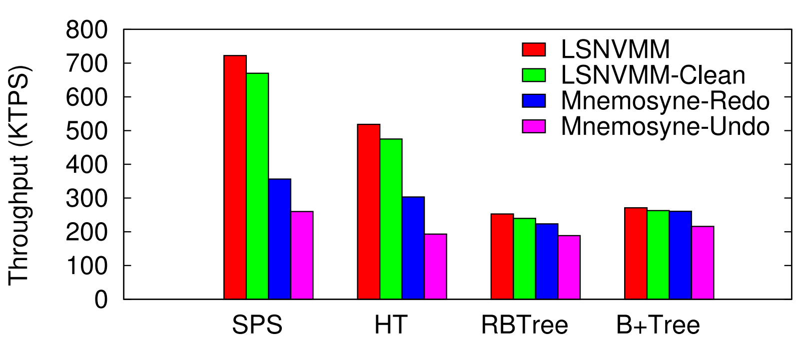
Evaluation
Transaction throughput compared to Mnemosyne
With 4 threads, log-structured NVMM performs 44.7% and 80.8% better than Mnemosyne and Mnemosyne-Undo, respectively, on average.

Slide 52
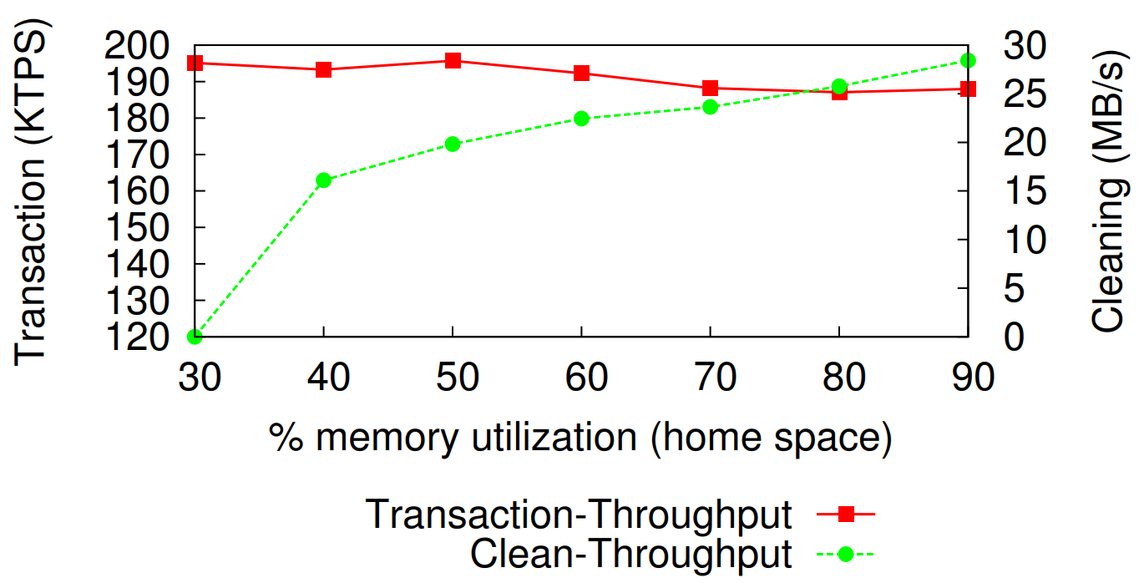
Evaluation
Cost of log cleaning
The performance degradation due to log cleaning is 8% at 90% memory utilization.

Slide 53
Conclusion
Takeaway I: Applying the log-structured approach to NVMM can largely reduce memory fragmentation and improve system performance.
Takeaway II: A tree-based address mapping mechanism can be made efficient to serve log-structured NVMM.

